Slide 1
Business Analysis
Project Management Institute
(Western India Chapter)
Mumbai
5th October 08
Prof Pradeep Pendse
Dean IT/Business Design
Welingkar Institute of Management

Slide 2
Book on BA
Title : Business Analysis
Author : Pradeep Pendse
Publisher : Prentice Hall India
ISBN : 978-81-203-3528-8
www.phindia.com

Slide 3
Agenda
Setting the Context
What’s New
Managing Requirements – Gathering
Modelling and Analysis
Innovation
Visualising IT Solutions
Human Centered Approach / Useability
Enterprise Analysis
  Information Architecture & Strategy
  Aligning IT Strategy
  Technology Forecasting and Selection
Quality and Security Requirements
Developing a Solutions Mindset

Slide 4
Setting the context

Slide 5
Evolution of the IT Industry
  Craft – Novelty - Development
  Mass Production – Commodity-Linking
  Process Enhancement – Quality-Modularisation
  Mass Customisation-Precision-Networking
  Co-Configuration-Customer Intelligence

Slide 6
Emerging role of a BA
Account Mgmt
Tech Architect
Project Mgmt
Consulting
Project Lead
Tech Lead
PreSales
Pure BA role
Functional Testing
Tech Analyst

Slide 7
What’s new ?
Requirements → Expectations
Gathering → Multisensing
Gathering → Analysis
Every Increasing Number of Perspectives
Analysis → Solutions Approach
Systems/Technology → Human Centred Approach
Security and Quality
Focus on Enterprise, Strategy & Transformation

Slide 8
Managing Requirements

Slide 9
Clues
Is equipped with an internal combustion engine
Is available in yellow, black, and yellow and black combination
Has three wheels
Has a parking brake and a foot brake
Has a 3-speed forward and a 3-Speed reverse gear box
Levels uneven surfaces nicely and quickly
Blast weights can be added to level different types of surfaces

Slide 10
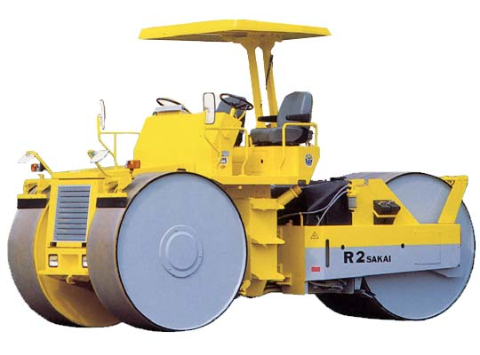
Answer

Slide 11
Requirements Management
Gathering
Multi Sensing &
Shaping Requirements
and Expectations
Understanding
the Context
and
the Big Picture
Analysis
Insights
Visualisation

Slide 12
Gathering Requirements

Slide 13
Observation – what to observe
Colin Robson (2202)
Space
Actors
Activities – what r they doing and why ?
Objects – what physical objects are present and why?
Acts – What r the specific individual actions ?
Events – Is it a part of a special event ?
Time – what is the sequence of events ?
Goals – what r the actors trying to accomplish
Feelings – mood of the group and of individuals ?
Ethnography

Slide 14
Studying a Business Process
Organisation and its Context
Strategic Directions
Purpose of Process
Context within which Process works
Process flow
Detailed Workflows
Transaction Documents
Volume of work
Resources deployed
Constraints
Decision Points in the process
Business Rules, Policies, Norms
Object Relationships
People – Roles and Tasks
Personas
Tracing the Life of a User
Extreme Conditions
Extreme Values for Data
Users Vision for Solution
….

Slide 15
Modelling and Analysing

Slide 16
Ever Increasing number of Perspectives
Process/ Workflows –
  Data flows, BPMN, Activity Diagrams, Flowcharts
Information Needs –
  CSF/KPIs,
  Info Required for Decisions
Process Structure
  Object/ Class Diagrams
  Decision Tables
  Business Rules Diagrams
Dynamic Process Behaviour
  Ethnography/ Observation
  Objects and Events
  States and Transitions
User View
  Life of a Hero
  Use Case View
  Personas
  Interaction/HCI Views
Enterprise View
  Business/ Orgn Metaphors
  Enterprise Architectural Views – Zachmann etc
Security and Quality View
  SQuaRE

Slide 17
Info Needs Perspective
CEO of Censor Board – CSF Method
Critical Success Factor
Volume of work done
Productivity
Cost
Compliance to the Cinematography Act
Safeguarding Public Sensibilities, Values etc
Fairness
Transperancy
Key Performance Indicator
No of Films
No of employees as a Denominator
No of Cuts levied – w.r.t Clause
No Certificates Issued – U/A/ UA etc
Avg Processing time for an application
Cost per film certified
No of Public Complaints received
No of Cases referred to Tribunal
Time reqd for complainant v/s avg time
Analysis of cuts for similar situations
Availability of above information to all stakeholders (RTI)

Slide 18
Why is Information Required ?
As a glue - Transactions
As a means of control & Coord
Self Control – Am I doing Well ?
Decision Processes
Reporting Upward
Strategic Cost Management

Slide 19
Newer Dimensions of Information Needs
Type of Data and Information – Text to video, audio etc
Informating & Learning
Knowledge Discovery
Innovation
Customer Bonding
Governance, Risk and Compliance
Information Economics
www, web2.0 and User Generated content
Newer Organisational architectures
Life Cycle View of Data and Information
Security and Privacy
Pervasive Technologies – mobile etc

Slide 20
Mind Map - Information Concepts
Information as a Corporate Asset
C - confidential
I - integrity
A - availability
Security as a Process
Threats and controls
Characteristics
Policy
Value, Price , Cost
Age & currency
Time / frequency
Right person
Right amount (overload)
right level o f privileges
Delivery modes
Needs vary with Hierarchy
Medium / format
Internal / External
Granularity
Accuracy v’s Precision
Presentation Bias
Vision
Security
Usage
Retention
Role & Responsibility
Security
Data
Meaningful
Capture
Validation
Processing
Storage
Retrival
Analysis / Interpretation)
Archival (Long Time Storage)
Disposal
Information
Processed
Organisation
Technology
Info & Info Systems relate to Orgnns
Organisation Structure, Form , Philosophy
Extra Organisational Systems
Organisational Metaphor for Information Use
Organisational Architecture
Uses of Information
Decision
Info Reduces Risk
Structured / Un Structured Decisions
Operational/Tactical/Strategic Decisions
Under Certainty/Under Risk/Uncertainty
Process Control
Online Transaction Processing
Product Lifecycle Mgmt
Enterprise Resource Planning
Decision Support Systems
Executive Information Systems
Supply Chain & CRM
E- Business
Benefits of IT –
Productivity
Business Process Transform
Business Network Transform
Business Scope Transform
Knowledge
Control
Decision Process
Self
Others
Reporting Upwards
Horizontal
Asking rate
Rational (Herbert Simon’s Diagram)
3 stages - Intelligence, Design & Choice
Behavioural Aspects –
- Satisficing Behavior
- Quasi Resolution of Conflict
- Impact of Size of Decision
- Behaviour after decision is taken
Informating
Capture
Reuse
Tacit
Explicit
Context
Application
Compliances
Info Architecture
Info System Controls
Info on Controls – Logs
visibility of Controls
Eg Sarbanes Oxley, HIPPA etc
Info BUS
Digit Nervous System (D.N.S.)
Client Server. (n-tire)
Layered
Publish – Subscribe & Portal
Onion peel – eg Core Banking
Basic Glue - Trasactions
Information supports Processes
Work flows – role , rule route

Slide 21
Information Strategy
Are Info Systems Aligned to Business Needs ?

Slide 22
Dynamic Process Behaviour
Object & Event Analysis
Example of Lecture Process
Events for Student Object
Comes late
Goes early
Asks questions
Replies to answers
Takes an Notes
Makes a presentation
Sleeps in class
Feels hungry
Object Analysis can be used for
Preparing checklists
Quick Estimation

Slide 23
State Diagrams
Open account
Open
do/deposits
do/withdrawal
Close / withdrawal [bal > 0]
Closed
exit/issue statement
deposit
Withdrawal [bal>0]
[no activity > 1 year]
Inactive

Slide 24
States – Customer Experience Design
States of a Shopper
At the Window - Confused – Is this shop for Me ?
Walking in – Un Comfortable – Am I looking Ok ?
Inside the shop – Confused – Where do I go now ?
At the Shelf - Unsure - Is this the right product ?
At the Billing Queue – Idle - ?

Slide 25
Object Relationships & Process Innovation
Guides Project
0..10
Pen (1)
Student
Teaches
Faculty
20..60
Cap (1)
Body (1)
0..5
Mentors
Refill (1)
Shell (1)
Why Should Faculty Mentor only 5 ?
Why Should a Pen have 1 Refill ?

Slide 26
Business Rules & Process Innovation
Bill Passed for Payment
Bill Not Duplicate
Material
Accepted
By Stores
Purchase
Order
Exist
Bill Received
Qty is as per PO
Material Okayed
by Quality Dept

Slide 27
Business Rules and Process Innovation
Faculty approved for teaching Course
Dean has recommended
EducationalQualification is OK
Work Experience
> 10 Yrs
PhD
Masters

Slide 28
Visualising Solutions

Slide 29






Visualising Use Cases
Purchase
Consumer
Stores
Stores Clerk
Accounts/Auditor

Slide 30
Use Case Approach
Identify Actors
Identify Business Events @ Actor
Each Event is a potential Use Case
Visualise Each Use Case (Dialog bet Actor and Machine)
Identify Screens
Design each screen
Construct a Prototype

Slide 31
Visualising a solution – Use Case
Chk Balance
Withdraw
Identify Use Cases
Deposit
Mini Statement

Slide 32
Visualising a Use Case
Normal flow
Customer
Selects Withdraw Option
Types amount
Confirms Amount
Collects Cash
Customer says ‘NO’
ATM
Logs in customer
Displays menu screen
Display Withdraw Screen
Seeks Confirmation of Amount
Processes Request
Dispenses Cash
Asks if more transactions ? Y/N
Logs out customer, ejects card
Displays default screen

Slide 33
Visualising a Use Case
Alternate flows and exceptions :
Wishes to change withdrawal amount
Requested Amount > Balance
Requested Amount > cash in ATM
Requested Amount > Cash limit for customer
More than one withdrawal during the same day
ATM fails – power, link etc
Error in disbursal of cash
Customer forgets to take cash
Customer asks for more transactions

Slide 34
Visualising a solution
Visualise Screens
  Default screen
  Menu Screen
  Withdrawal Screen
  Confirmation of amount
  More Transactions ?
  ….

Slide 35
HCI & Useability

Slide 36
Human Computer Interaction & Useability
Goals
  Business Goals
  IT Goals
  User Experience Goals
Useability Goals
  Functionality
  Efficiency
  Attractiveness
  Making things simple and intuitive
  Ease of learning
  Safety and security

Slide 37
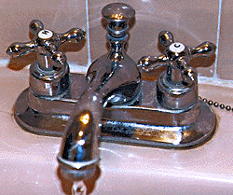
HCI /Useability tools
Ethnographic Studies
Identification of Users and defining personas
Affinity Diagrams
Life of a Hero
Task analysis
Application of Design Principles
Use of Metaphors and anologies

Slide 38
HCI/Useability
New Subjects to learn
Design principles/elements
  Colour
  Form
  Shape
  Aesthetics
  Balance
  etc
Anthropology
Semiotics
Semantics
Typography
Visual Language
Cognitive Psychology
Perception
etc

Slide 39
Use of Metaphors for Visualisation
Browsing
Surfing
Windows
Pipes
Filters
Pointing
Java/Java Beans
Agent
Broker
Queue
mail
Folder /file
Desktop
Button
Hour glass
Avatar
Etc

Slide 40
Enterprise Analysis

Slide 41
Enterprise Analysis
Business Strategy Frameworks
Michael Porter’s Industry Structure Analysis
Information architecture & Strategy
Zachmanns Framework
Metaphors & Information Architecture
SIA framework
Strategy Alignment & focus
Critical Success Factors
Alfred Chandler’s
Nolan’s EDP Lifecycle
McFarlan’s Strategic Grid
Frameworks for Evaluating IT Strategy/Investments
Technology Diffusion models
  Roger Moore
Technology Forecasting & Selection models
  Gartner’s Hype Curve
  Gartner’s Magic Quadrant

Slide 43
Information Architecture - Metaphors
Digital Nervous System
Onion Peel
Information Bus
Layered Architecture
Service Oriented Architecture
What is the best architecture for me ?

Slide 44
Information Strategy
- Information Architecture
How should information be created and used in my organisation ?
Architecture is about –
  Broad Structural components for Information
  The rules for interaction
  The desired business outcomes
  Consistent and repeatable Style
  Identity for the organisation

Slide 45
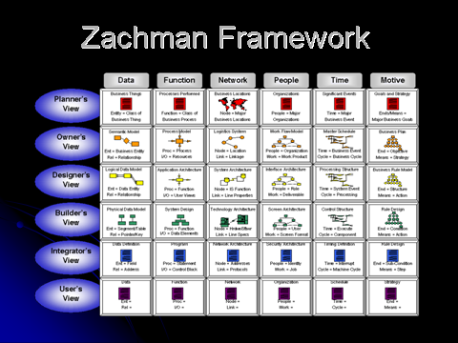

Slide 46
Conceptual Frameworks for Information Systems Planning
Zachmann’s Framework
SIA Framework
CSF Methodology
Alfred Chandler’s Strategy Trilogy
Nolan’s – EDP Life Cycle
Cash & McFarlan’s Strategic Grid
Adequacy Grid
Strategic Information management Framework
Strategic Information Systems Planning – Venkataraman et all
IT Performance Management Grid
Portfolio Management Matrix

Slide 47
Information Strategy
-Information for Strategic Advantage
Add Value
Reduce
Costs
Reduce
Risk
Create New Reality

Slide 48
Information Strategy
-Information for Strategic Advantage
Are Info Systems Aligned to Business Needs ?

Slide 49
IT Strategy Alignment

Slide 50
IT Strategy
- Alignment of IT Strategy
Business Strategy
Organisational Strategy
Systems/IT Strategy

Slide 51
IT Strategy
-Direction of IT Investments
Impact
MacFarlan’s Strategic Grid
High
Turnaround
Strategic
Support
Factory
Low
Low
High
Dependence

Slide 52
IT Strategy
-Direction of IT Investments
Impact
MacFarlan’s Strategic Grid
High
ATMs in early 90s
ATMs in the late 90s
ATMs today
Low
Low
High
Dependence

Slide 53
Planning of Info Systems
Nolan’s -EDP LifeCycle
Initiation
Integration
Maturity
Contagion
Admin
Decline

Slide 54
Planning of Info Systems
Nolan’s -EDP LifeCycle
Initiation
Integration
Maturity
Contagion
Admin
Decline

Slide 55
Planning of Info Systems
Technology-Functional Adequacy Model
Functional Adequacy
0,9
9,9
High
Low
Scrap/Rewrite
9,0
0,0
Low
High
Technical
Robustness

Slide 56
Business and IT alignment
Functional
Integration
IT strategy
Business Strategy
Strategic fit
Strategic fit
Organisational
Infrastructure
And Processes
IT Infrastructure
And Processes
Functional
Integration

Slide 57
IT Performance Management Grid
IT Demand
Business Support
IT Based offering
Mission Critical
Value added
service
IT Supply
Application Services
Infrastructure
IT Performance Management – by Wiggers et all

Slide 58
Portfolio Management Matrix
High
Medium/Low Priority
High Priority
Strategic Contribution
Low
Low Priority
Medium Priority
Low
High
Financial Contribution
IT Performance Management – by Wiggers et all

Slide 59
Classifying IT Investments
Investment Match Business Objectives with type Of IT Project
B
E
N
E
F
I
T
Soft
Architecture
R&D
Effectiveness
Competitive
edge
Must
Do
Efficiency
Hard
‘Soft’
Costs

Slide 60
Matching Projects to Techniques
Investment Match Eval Techniques with Tasks on Hand
B
E
N
E
F
I
T
Soft
Return on Mgmt
R&D
Info Econ
Competitive
edge
Performance
Metrics
Cost Benefit
Risk Analysis
Head
NPV
‘Soft’
Costs

Slide 61
Technology Forecasting & Selection
Peak of Hype
Nano Tech
RF-ID
Maturity
ERP
E-Biz
Trough of Disillusionment
Gartner’s Hype Curve

Slide 62
Technology Forecasting & Selection
High
SAP
Ramco Marshall
Product Vision
Retek (retail ERP)
Low
Low
Ability to Execute the Vision

Slide 63
Security & Quality Requirements

Slide 64
Quality
Functional v/s Non-Functional Requirements
Quality in Use
Internal quality Requirements
External quality requirements
Process Quality
Metrics and standards
Verifying quality

Slide 65
Security
Functional requirements
- What the software should do
Security Requirements
– What the software should NOT do

Slide 66
Techniques for eliciting & modelling Security requirements
Non-use case
Attack trees

Slide 67
Developing a Solution Mindset

Slide 68
Design thinking
Thinking like a Designer
  About Creation
  co-Creation
  Multidisciplinary
  Idealise
  Comfort in ambiguity
  Empathy
  Focus on Needs
  Multisense
  Be Creative
  Observe Deeply
  Think Critically
  Think Holistically
  Think Visually
  Think Abstract
  Abductive Thinking
  Experiment
  Be Hands-On
  Communicate

Slide 69
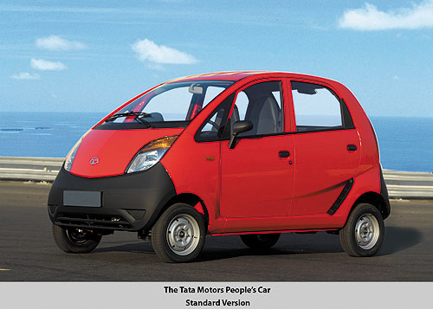



Where can You apply Design Thinking ?
Products
Brands
Processes
Services
Customer Experiences
Organisations Structure
Business Models
Business Strategy
Community Projects
etc

Slide 70
How does Design led innovation happen ?
Incremental improvements – new features, markets, positioning
Disruptive Innovation
Deep involvement with user community or community at large
User do not necessarily know what they want – vision for future
Help create New language and meaning
Challenge existing norms, practices
Create platforms
Create an entire eco-system to support
Co-create with others in the same or other domains
Dominant Design
Design Classics
Modularity
Parallel Inventions & Parallel Innovations
Open innovation

Slide 71
Innovation Personas
(7 faces of innovation -Tom Kelly)
Learning Personas :
  The Anthropologist
  The experimenter
  The Cross-Pollinator
Organising Personas
  The Hurdler
  The collaborator
  The Director
Building Personas
  The experience Architect
  The set Designer
  The care giver
  The story teller

Slide 72











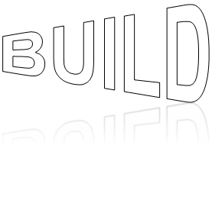




A
?
K
S  E
Re
-
design
I
N
N
O
V
A
T
E
SHOW
&
TELL

